Slide 1


Slide 2


Slide 3
Why is this so important?
OKCPS has aging and inefficient facilities
Old buildings require costly maintenance
Facilities were not designed to serve 21st century students
Allow OKCPS students to compete with their peers in neighboring districts
Amplify what programs we are already offering and add new programming

Slide 4
In the last 12 years…
Tulsa
~$34,000
dollars per student
Edmond
~$19,000
dollars per student
OKCPS
~$5,000
dollars per student
Moore
~$24,000
dollars per student
Notes:
Represents a students career from PK to graduation
If the OKCPS bond passes, our number goes to $35,000

Slide 5

Student Benefits

Slide 6
Athletics

Slide 7

Library Media

Slide 8
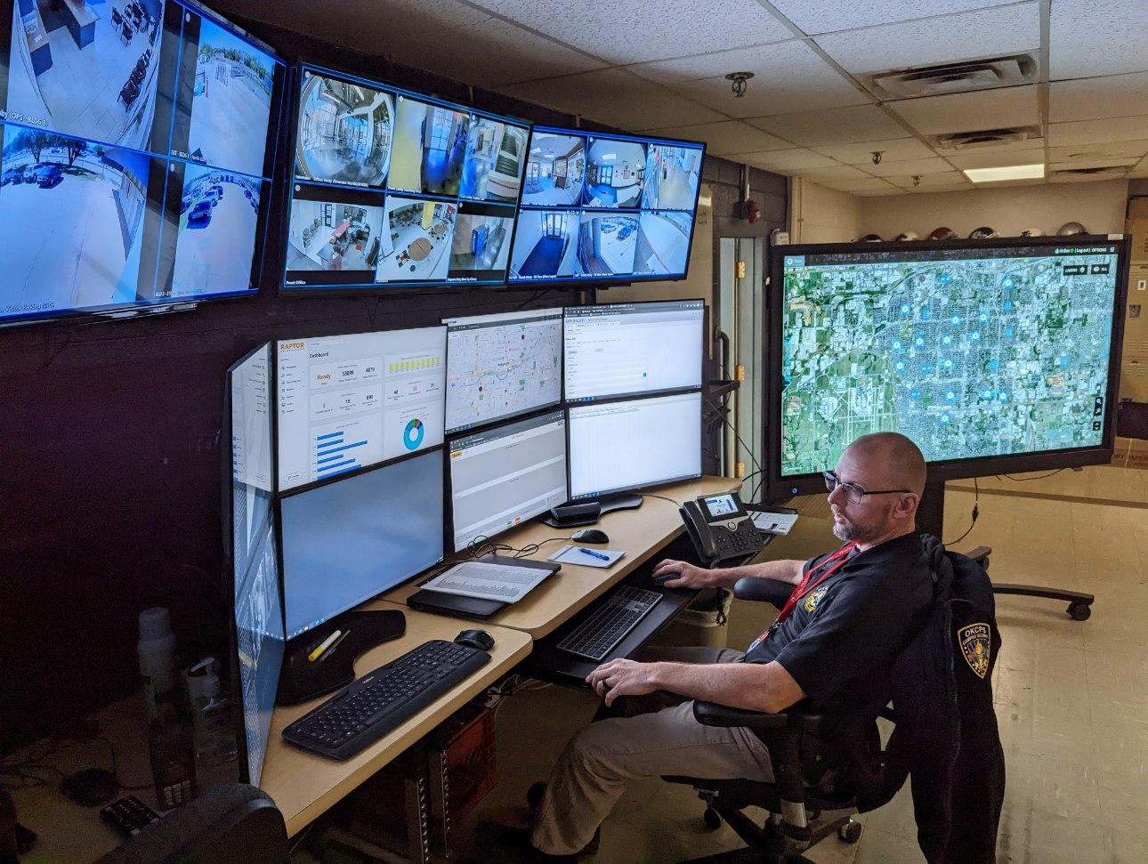
Safety & Security

Slide 9
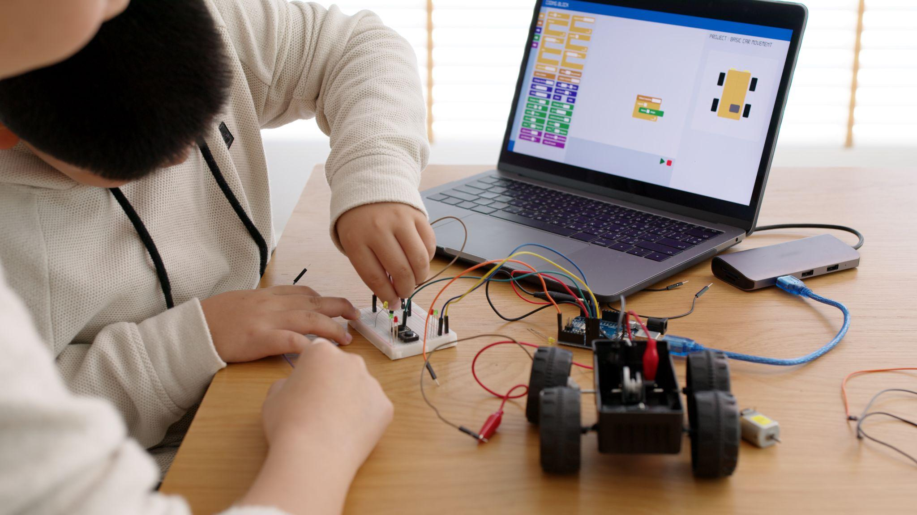
Technology

Slide 10
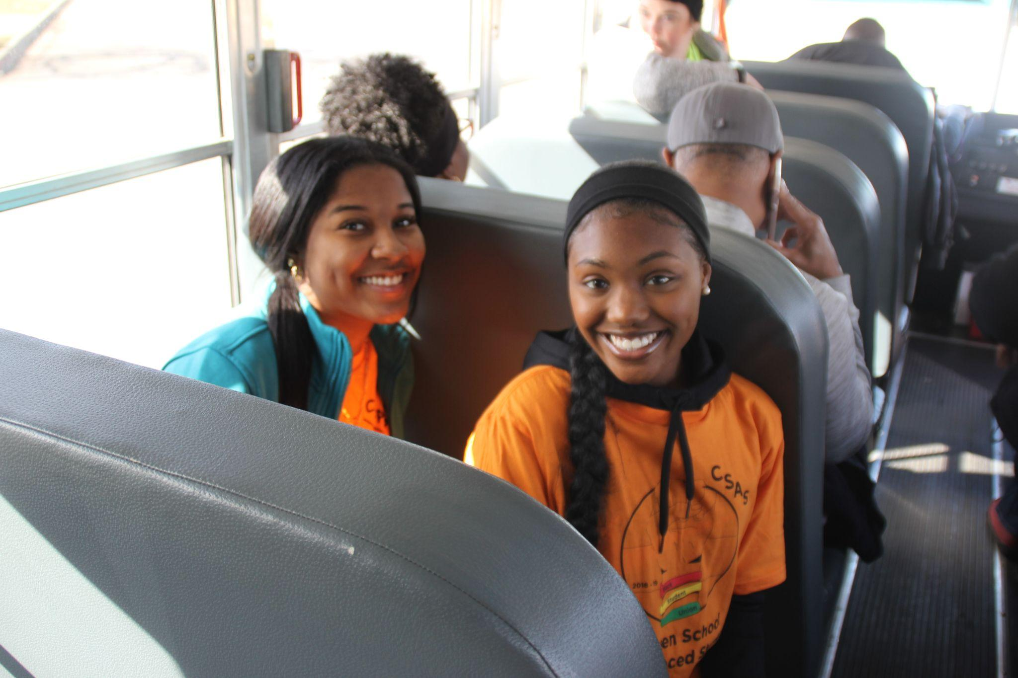
Transportation

Slide 11

Visual & Performing Arts

Slide 12
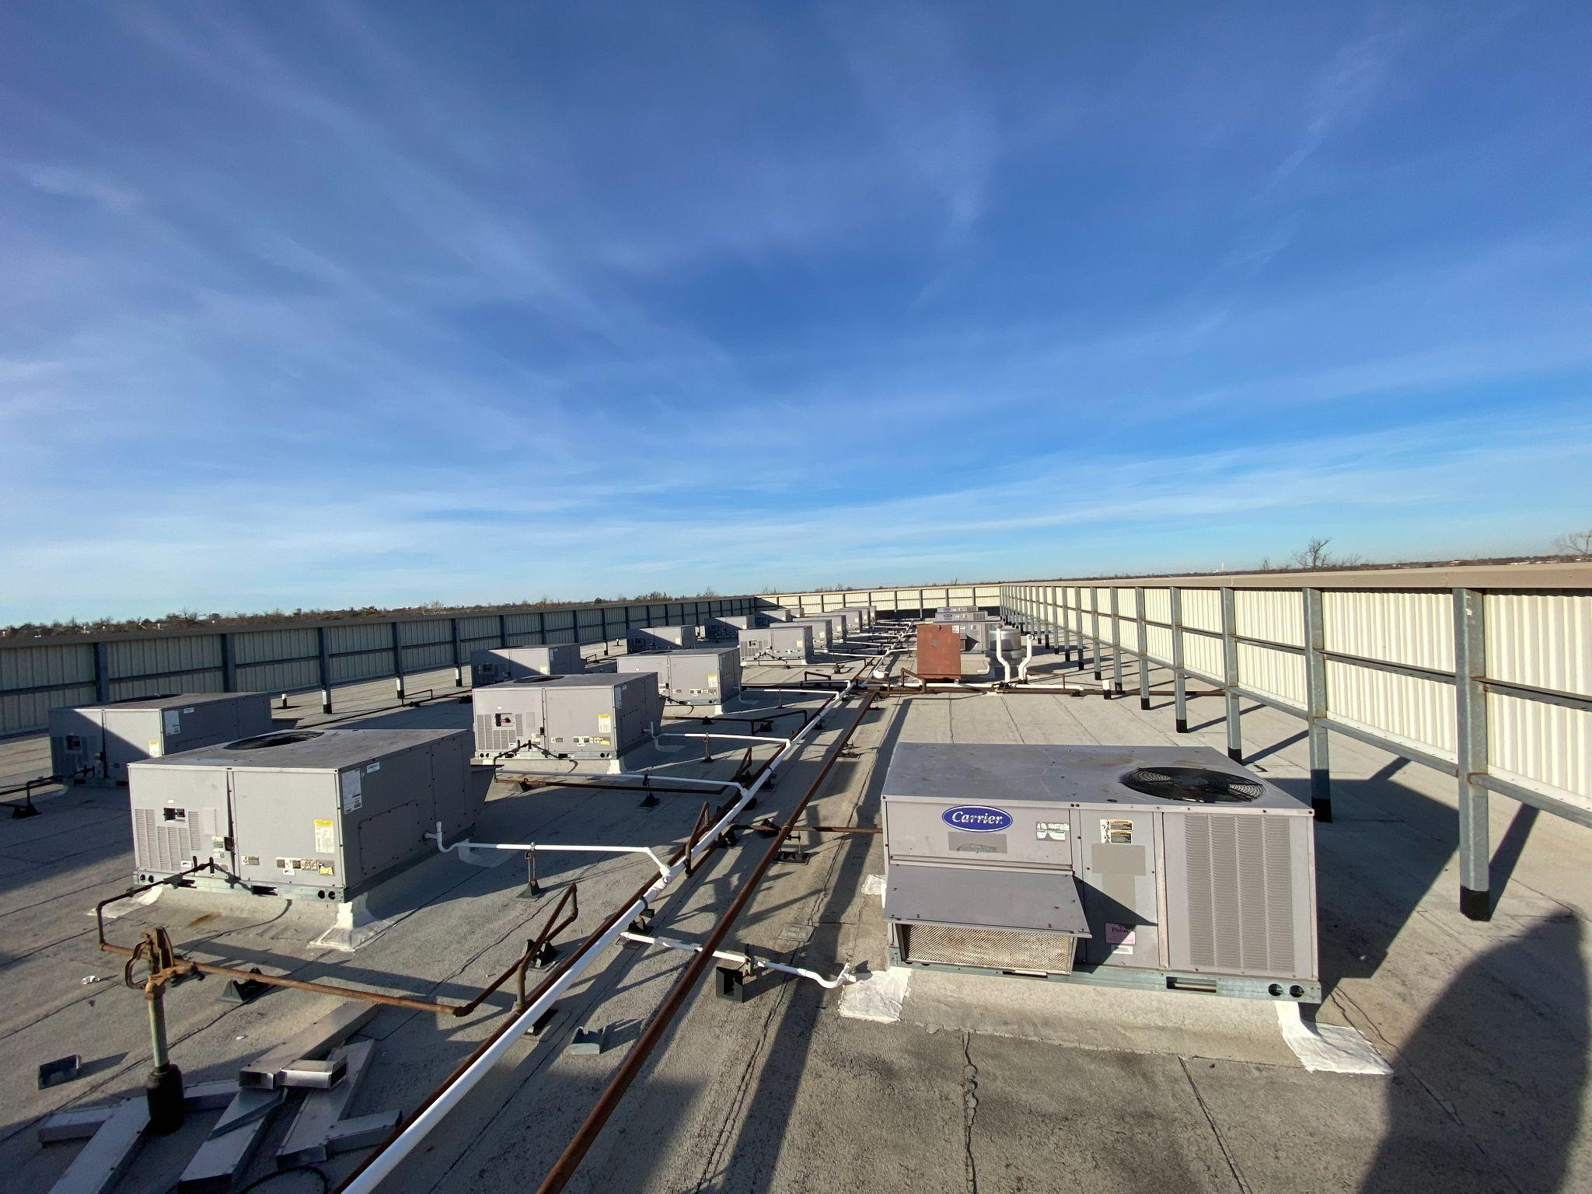
Facility Improvements & Maintenance

Slide 13
US Grant Feeder
Notes:
Tonight we will talk about the projects that will impact the

Slide 14
US Grant High School
Jefferson Middle School
Roosevelt Middle School
Hillcrest
Prairie Queen
Southern Hills
Adams
Arthur
Coolidge

Slide 15
Bond Projects
SITE | Bond Project(s)
Adams ES | Renovate drop-off and outdoor play area
Arthur ES | Create a walking trail Parking and fence renovation
Coolidge ES | Parking and courtyard redesign
Hillcrest ES | Restroom, track and fence renovation
Jefferson MS | 3 classroom addition Locker room renovation Competitive gym addition
Prairie Queen ES | Parking and outdoor play area renovation
Roosevelt MS | Gym and locker room renovation
Southern Hills ES | Parking lot renovation and new walking trail
US Grant HS | 12 classroom addition and new Little Generals area Cafeteria expansion and outdoor eating area Flexible Space addition

Slide 16
US Grant High School

Slide 17
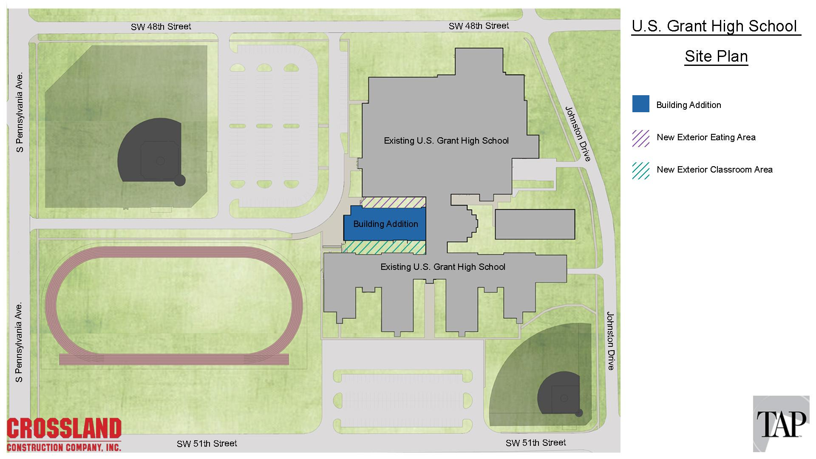

Slide 18


Slide 19
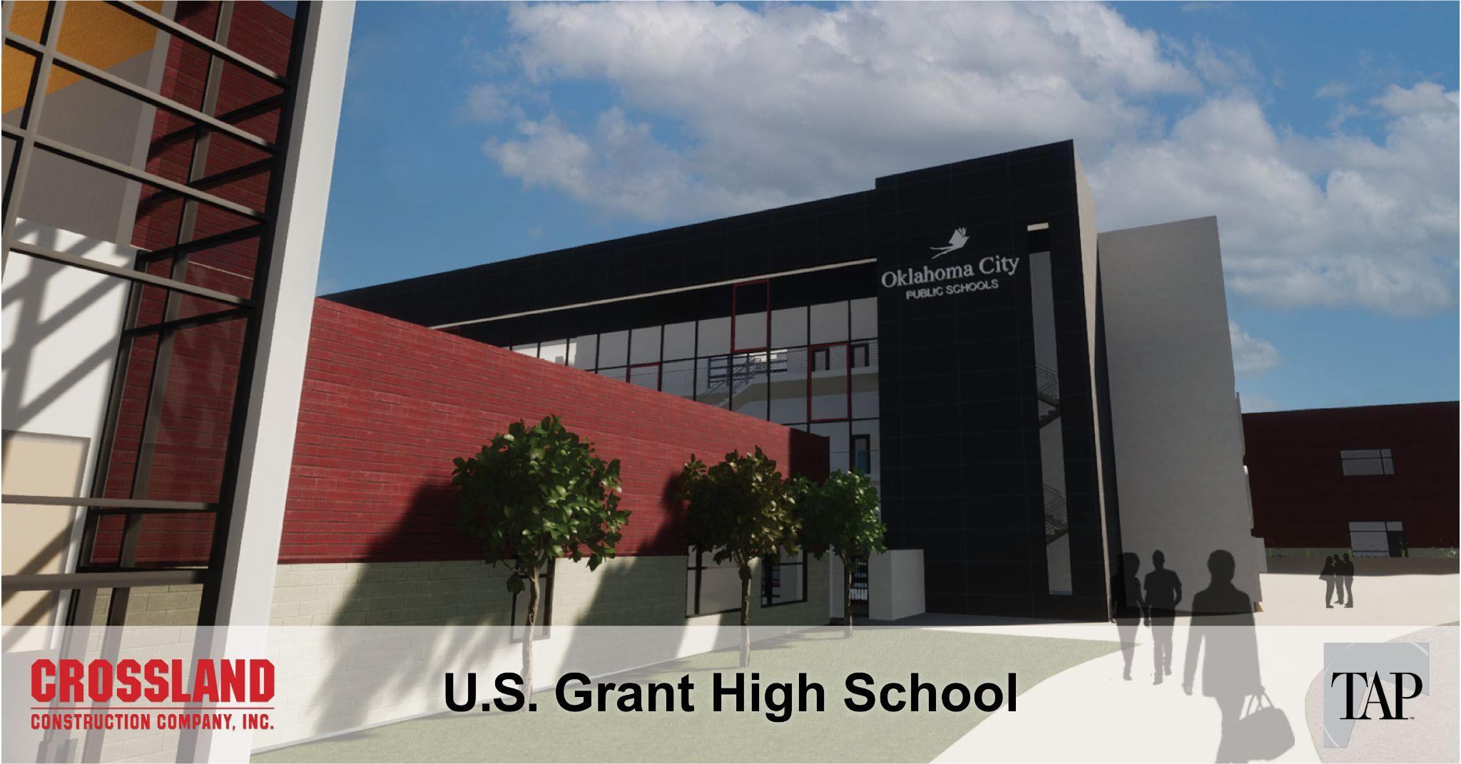

Slide 20
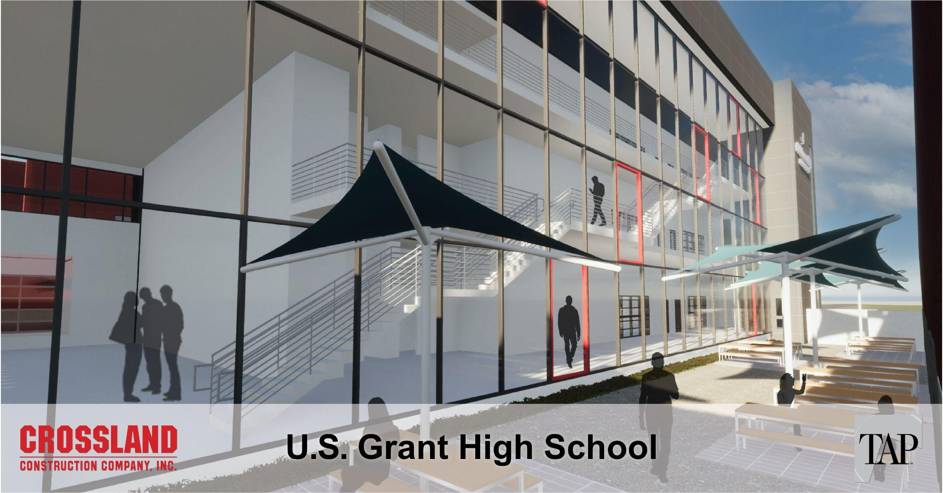

Slide 21


Slide 22


Slide 23
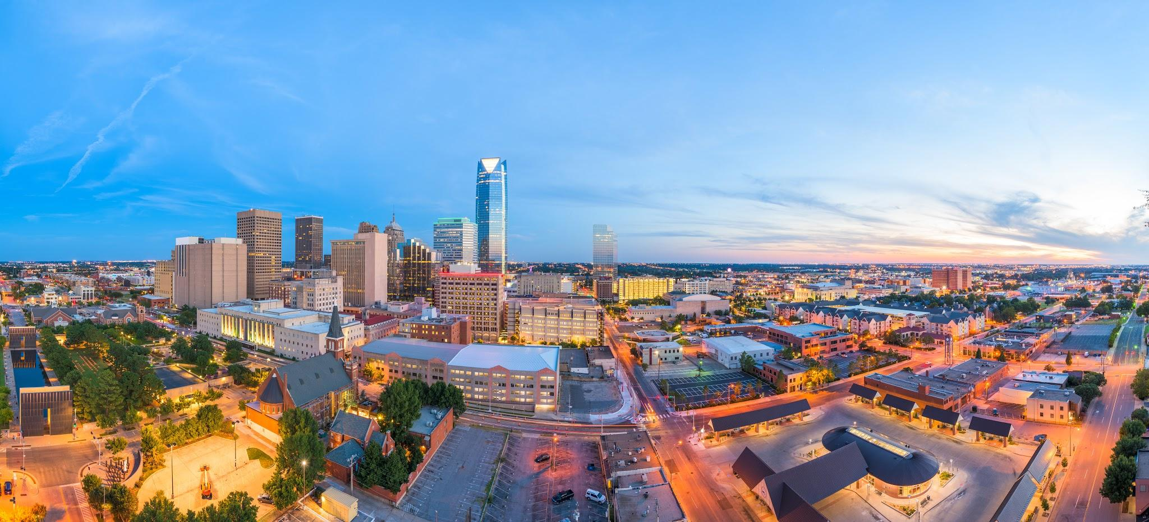


Slide 24

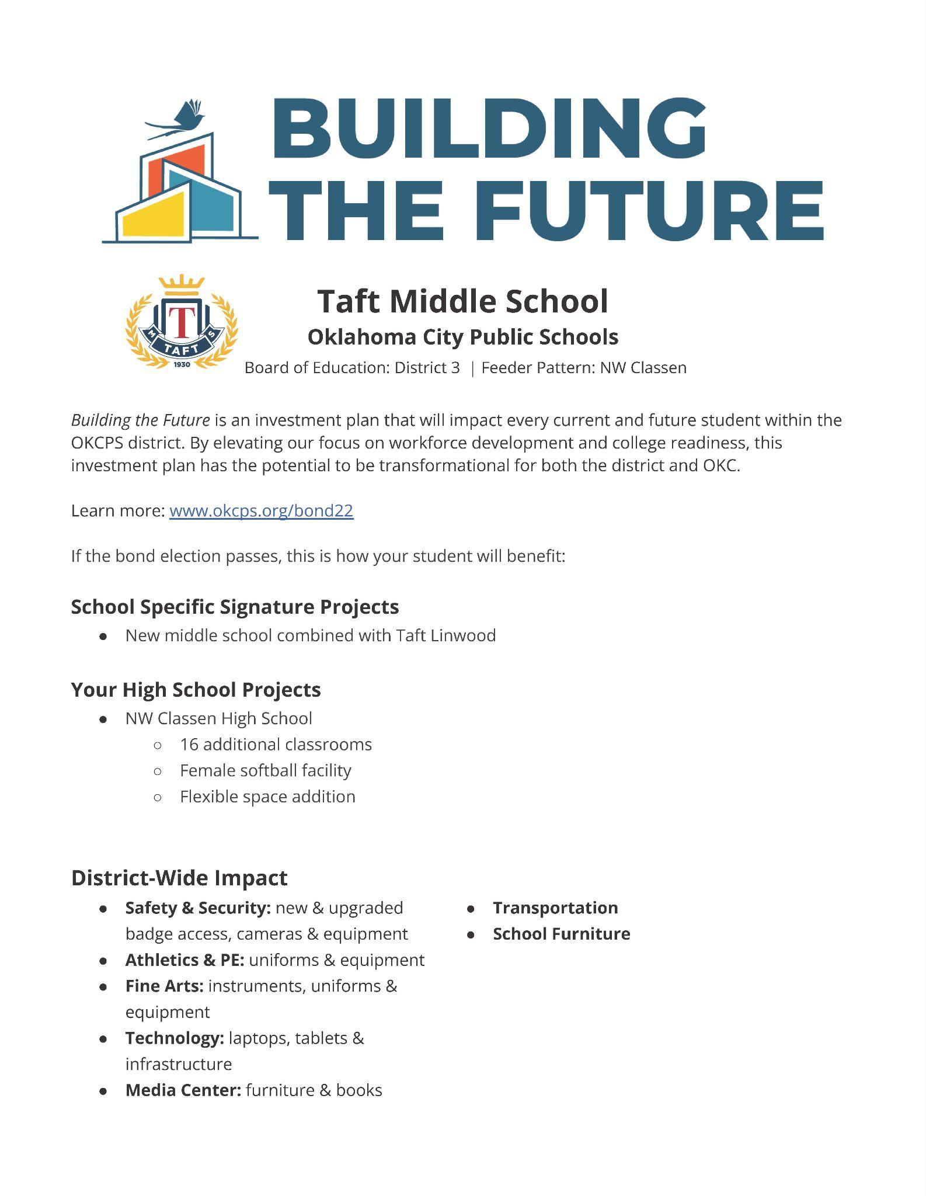


Info Sheets

Slide 25

Website
www.okcps.org/Bond22

Slide 26
What’s Next
5 minute break
Visit tables in the hallway for any questions
Vote November 8

Slide 27


